Slide 1
Customer Feedback Pipeline
Sam Law

Slide 2
Project Features
Pipeline
Provide Tkinter GUI for customer to submit feedback
Using Bert model to analyse the sentiment of the feedback
Store both the comment and sentiment into database
Terminal interface for interaction with sentiment data
Show all the feedback record in the database
Sentiment statistics
Visualization

Slide 3
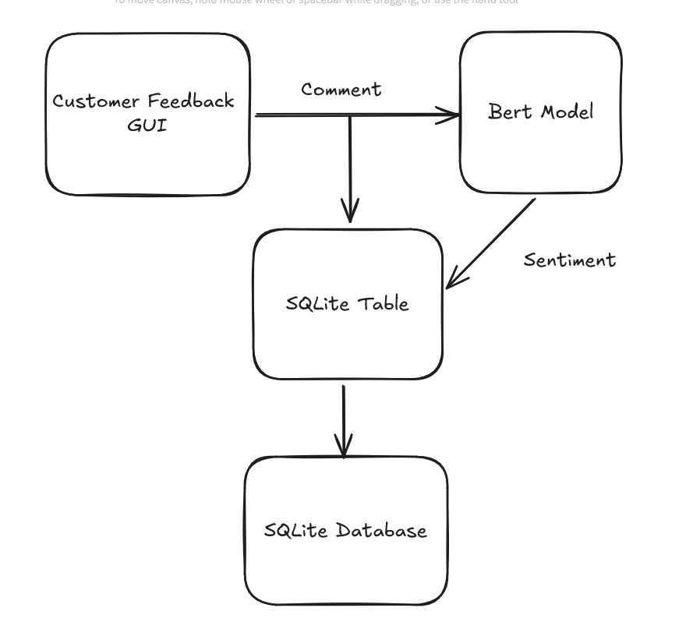
Customer Feedback flowchart

Slide 4
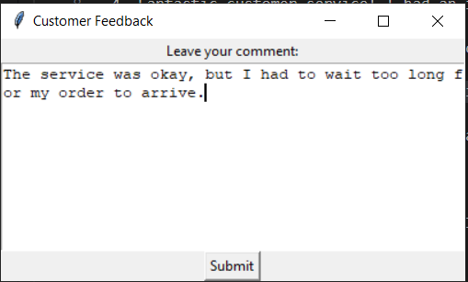
Customer Feedback GUI

Slide 5
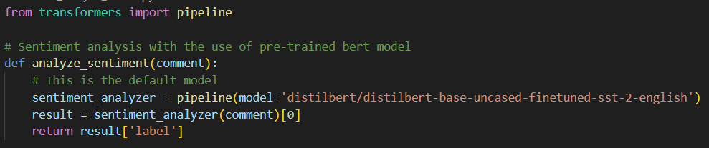
Sentiment Analysis
Output

Slide 6
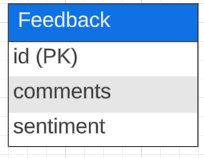
Database Schema

Slide 7
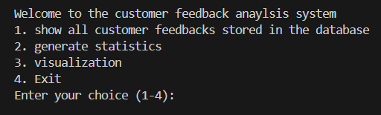
Terminal Interface

Slide 8
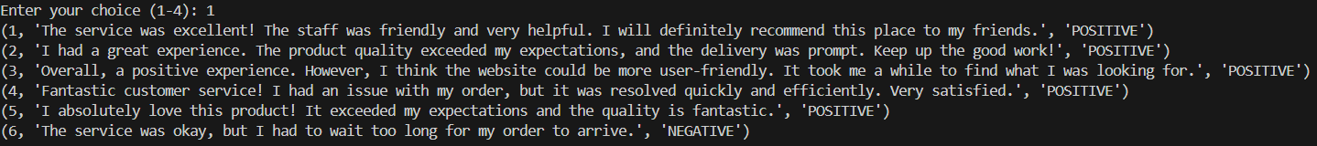
Option 1: Print feedbacks

Slide 9
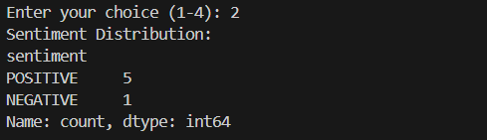
Option 2: Generate Statistics

Slide 10
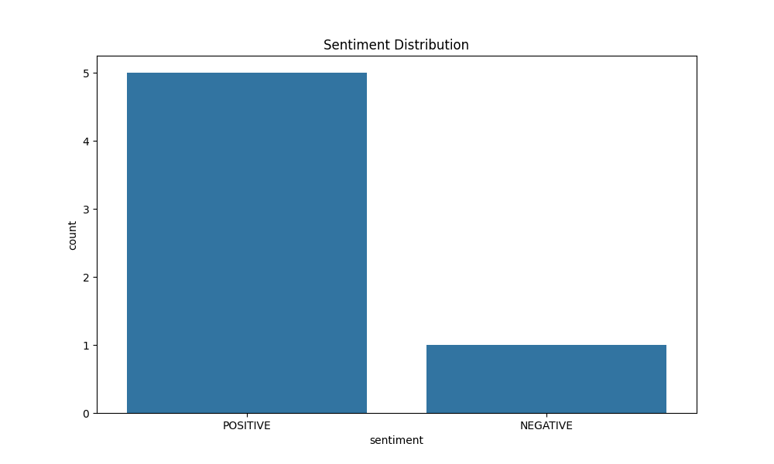
Option 3: Visualization

Slide 11
Future Extension
Common topics
Find out what kind of common topics the customers are concern about the most
Pinpoint the strengths and weaknesses
Frequency of keywords
Find out what kind of word shows up the most
Feedback collection specific to each product
Pinpoint the strengths and weaknesses per product

Slide 12
Thank you

